Slide 1

Model
View
Controller
Trainer markova.milica@gmail.com
Assistant ristopavlov@gmail.com
Notes:
Overview from Class 1:
MVC is an architectural design pattern meaning that it resolves issues with organization and structuring of software architecture.
A lot of times MVC is confused with a framework, since a lot of frameworks use MVC as their main architectural pattern, but the mvc is just the idea of how to organize stuff.
We will use HTML, CSS and JavaScript to create the front-end and C# and MSSQL to create the back-end of our applications.
Knowledge of building a front-end web site using HTML, CSS and JavaScript
Knowledge of C# and it's features
Knowledge of manipulating databases using MSSQL
Installed Visual Studio 2017
Updated Visual Studio 2017 with all necessary features
Why MVC is awesome?
Organizing the code making it easy to get around
Structure the code so that we don't duplicate code
Separate concerns so that we can easily change things without affecting the whole application
Separate the user and the data so that users do not have direct contact with our data
Scale and develop our application faster and safer

Slide 2
Module Contents
ASP.NET MVC
MVC Concept
Controllers
Controller Actions
Controller Action Return Types
Views
Razor View Engine
Partial Views And HTML Helpers
Naming Convention
Code academy @ Skopje, 2018-2019

Slide 3
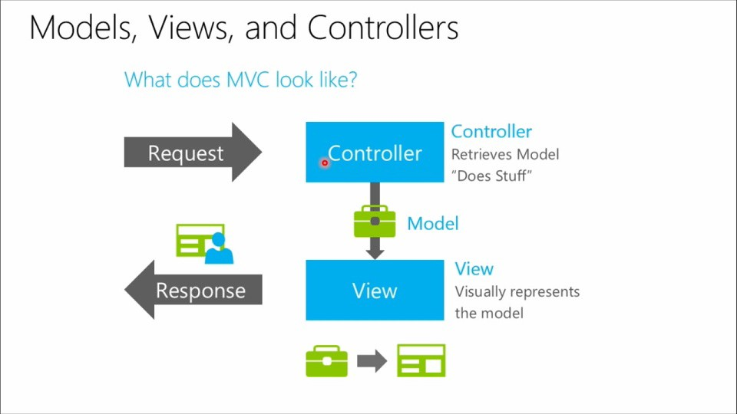
MVC Concept
ASP.NET MVC
Code academy @ Skopje, 2018-2019
Notes:
MVC Concept
MVC or Model View Controller is a design pattern.
A design pattern is not a technology.
It is not some code.
It is not some framework that we download.
Design patterns are structured ideas or concepts that solve some problem and can be followed to solve problem of the same nature in the future.
When building applications with the MVC design pattern in mind we want to divide our code in 3 parts. Model, view and controller.

Slide 4
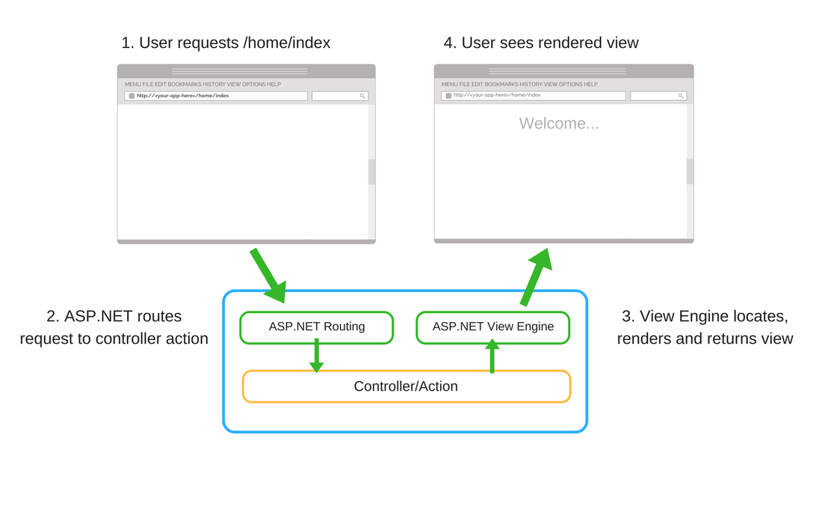
Controllers
ASP.NET MVC
Code academy @ Skopje, 2018-2019
Notes:
Controllers
The controller is the middle man of the whole operation. The controller has 2 main responsibilities.
Accepting requests from the view ( user interactions ), processing those requests to a suitable format and informing the model of the request
Accepting data from the model, shaping it in a suitable response and returning the response data to the view ( result that the user sees )
This means that the view ( where the user interacts ) never knows what is happening with the data ( the model ). This makes our data much more secure and safe and also separates the concerns of our layers in the application.
Controllers in ASP.NET MVC are simply classes with methods (Actions).
The controller class you create must always inherit from an existing controller class from the asp.net framework
The controller class must always be in a folder called controllers.
Create our own class. This is done by right clicking on the Controllers folder -> Add -> Controller and choosing the MVC Empty template.
ALWAYS HAVE Controller at the end.

Slide 5
Controller Actions
ASP.NET MVC
Represent an endpoint of the Web Application
Controller can also have multiple actions
Can be used for routing
Can take binded parameters from the http request
Can have various return types
Code academy @ Skopje, 2018-2019
Notes:
Controller Actions
Actions are basically the methods that we have in the controller.
Actions are the main source of interaction in and out of the controller.
Every action has an address and when that address is called, the action is executed.
With this the action can execute some code and return a view or a view with some result in it.
We can have actions that wait for a GET request, POST request etc.
In ASP.NET Core MVC applications if we don't annotate our actions, they are by default GET. If we want to explicitly mark an action with what kind of request it waits we can use the [HttpXXX] attribute. Ex: GET -> [HttpGet]
Represent an endpoint of the Web Application
Controller can also have multiple actions
Can be used for routing
Can take binded parameters from the http request
Can have various return types
HttpGet method sends data using a query string. The data is attached to URL and it is visible to all the users. However, it is not secure but it is fast and quick. It is mostly used when you are not posting any sensitive data to the server like username, password, credit card info etc.
HTTPPost method hides information from URL and does not bind data to URL. It is more secure than HttpGet method but it is slower than HttpGet. It is only useful when you are passing sensitive information to the server.

Slide 6
Controller Action Return Types
ASP.NET MVC
Result Class | Description
ViewResult | Represents HTML and markup.
EmptyResult | Represents No response.
ContentResult | Represents string literal.
FileContentResult/ FilePathResult/ FileStreamResult | Represents the content of a file
JavaScriptResult | Represent a JavaScript script.
JsonResult | Represent JSON that can be used in AJAX
RedirectResult | Represents a redirection to a new URL
RedirectToRouteResult | Represent another action of same or other controller
PartialViewResult | Returns HTML from Partial view
Code academy @ Skopje, 2018-2019
Notes:
Controller Action Return Types
The View method returns a ViewResult
ViewResult does not have constructor with arguments
The results that the action gives back to the browser whether it is a view or some other type of result is always packaged in an Action Result.
ViewResult - A result used when we want to return some view
RedirectResult
RedirectToAction accepts an action name (string) and redirects to that action from the same controller – “return RedirectToAction("Index")”
RedirectToAction accepts an action name(string) and a controller name(string) and redirects to that action from that controller – “return RedirectToAction("Index", "Orders")”
JsonResult - accepts an object, converts it to json automatically and returns it
var order = new { Id = 12, IsDelivered = false }; // Dummy Order
return new JsonResult(order); // return type: JsonResult

Slide 7
Demo
ASP.NET MVC
Controller
Controller Action
Create View
Check for other return types
Create controller from templates
Code academy @ Skopje, 2018-2019
Notes:
To access our actions in our controllers from the browser we need an address
Handling of requests to addresses is called routing and the addresses to the actions are called routes
default the routes of our ASP.NET MVC project
website(localhost)/ControllerName/ActionName
website(localhost)/ControllerName/ActionName/ExtraParameter
Keep in mind that the name of the controller should be written without the Controller suffix
If we want to add custom routes we can do that in two ways:
By changing the router (The router can be found in StartUp.cs in the Configure method)
app.UseMvc(routes =>
{
// This route will be accessed through these addresses:
// localhost:port ( default )
// localhost:port/anyControllerName/anyActionFromThatController
// localhost:port/anyControllerName/anyActionFromThatController/someParameter
routes.MapRoute(
name: "default",
template: "{controller=Home}/{action=Index}/{id?}");
// This is a custom route called orders and will be accessed through:
// localhost:port/orders
routes.MapRoute(
name: "orders",
template: "orders",
defaults: new { controller = "Order", action = "Index" });
});
By adding routing attributes to our action or controller (Attributes are rules that we add in [ ] above methods or classes)
// Custom route for the controller. Action names stay the same
[Route("App/[Action]")]
public class HomeController : Controller
{
public IActionResult Index() // localhost:port/app/index
{ return View(); }
public IActionResult Contact() // localhost:port/app/contact
{ return View(); }
}
[Route("App")]
public class HomeController : Controller
{
[Route("Start")]
public IActionResult Index() // localhost:port/app/start
{ return View(); }
[Route("CallMe")]
public IActionResult Contact() // localhost:port/app/callme
{ return View(); }
}

Slide 8
Views
ASP.NET MVC
In ASP.NET MVC, the View is a template for generating HTML as response of the http request
Contains mix of C#/VB and HTML
File extensions: .cshtml or .vbhtml
Views allow model binding (...more on this later)
Code academy @ Skopje, 2018-2019
Notes:
Views
An action can return a view.
This means that if someone were to access the address of that action through the browser, they will get an HTML page back.
In ASP.NET MVC, the View is a template for generating HTML as response of the http request
Contains mix of C#/VB and HTML
File extensions: .cshtml or .vbhtml
Attaching a view to an action can be done by creating a folder with the controller name in the Views folder and inside create a file the same name as the action (default routing configuration)
That was the manual approach. Visual Studio offers a shorter and automatic way of doing this. (Right click on the action itself (the line of code where we declare it ) there is an option Add View.)
Views allow model binding (...more on this later)
Model binding is a mechanism ASP.NET MVC uses to create parameter objects defined in controller action methods. The parameters can be of any type, from simple to complex ones.
It simplifies working with data sent by the browser because data is automatically assigned to the specified model.

Slide 9
Razor View Engine
ASP.NET MVC
Master Layout views are supported in Aspnet
Allows combination of HTML and C#(or VB) code
@ indicates server side C# or VB code
File extension is .cshtml or .vbhtml
Views should contain as less server side code as possible
Code academy @ Skopje, 2018-2019
Notes:
Razor View Engine
Razor View Engine is a markup syntax which helps us to write HTML and server-side code in web pages using C# or VB.Net.
It is server-side markup language however it is not at all a programming language.
Some of Razor Syntax Rules for C# are given below.
It must be always enclosed in @{ ... }
Semicolon “;” must be used to ending statements
Files have .cshtml extension.
Variables are declared with var keyword
Inline expressions (variables and functions) start with @
C# code is case sensitive
Views should contain as less server side code as possible
Master Layout views are supported in Aspnet
An application may contain common parts in the UI which remains the same throughout the application such as the logo, header, left navigation bar, right bar or footer section.
ASP.NET MVC introduced a Layout view which contains these common UI parts, so that we don't have to write the same code in every page.
The layout view is same as the master page of the ASP.NET webform application.
Layout views are shared with multiple views, so it must be stored in the Shared folder.
The following is an auto-generated _Layout.cshtml.
RenderBody acts like a placeholder for other views
You must be wondering that how would the View know which layout view to use? - _ViewStart.cshtml
_ViewStart.cshtml file can be used to specify path of layout page
You can set the Layout property in the individual view also, to override default layout page setting of _ViewStart.cshtml
Layout view uses two rendering methods: RenderBody() and RenderSection().
RenderBody method renders all the content of view which is not wrapped in named section.
RenderSection method renders the content of a view which is wrapped in named section
The layout view eliminates duplicate coding

Slide 10
Partial Views and HTML Helpers
ASP.NET MVC
Partial views
Allow reusability of razor code
It's a good practice to reuse the code using partial view
Are the lowest element in Views Hierarchy
HTML helpers
Various of html helpers come along with the framework by default(validation,forms,display)
You can create your own custom html helpers
Code academy @ Skopje, 2018-2019
Notes:
Partial Views And HTML Helpers
Partial views
Partial view is a reusable view, which can be used as a child view in multiple other views.
You can render the partial view in the parent view using html helper methods: Partial() or RenderPartial() or RenderAction().
Allow reusability of razor code
It's a good practice to reuse the code using partial view
Are the lowest element in Views Hierarchy
HTML helpers
HtmlHelper class generates html elements using the model class object in razor view.
So always use HtmlHelper class in razor view instead of writing html tags manually.
@Html is an object of HtmlHelper class
<p>
@Html.ActionLink("Tset","Error")
</p>

Slide 11
Naming Convention
ASP.NET MVC
Controllers
path: /Controllers/
pattern: [ControllerName]Controller.cs
example: MonstersController.cs
Views
path: /Views/[ControllerName]/actionName
pattern: [ActionName].cshtml
example: /Views/Monsters/EditMonster.cshtml
can have different name than
Code academy @ Skopje, 2018-2019

Slide 12
?
ASP.NET MVC
Code academy @ Skopje, 2018-2019

